Slide 1
IBM University Engagement Project Submission
“Exploring the Power of Agentic AI with IBM Granite and IBM Bob”

Slide 2

Project Tile – [Smart Study Generator Agent]
Domain of Project – [AI & ML]
Student Name | Recent Passport Photo | Email ID | Mobile number [WhatsApp]
M MANASA |  | mangalamanasa27@gmail.com | 6309928227

Slide 3
Problem Statement -
Problem Statement No: Smart Study Generator Agent
The Challenge
Students today face an overwhelming flood of information—lecture notes, textbooks, research papers, YouTube tutorials, and online resources. This content is scattered, unorganized, and often not personalized to their learning pace or style. As a result, students struggle with finding the right study material, summarizing key concepts, and staying exam-ready. Traditional study tools only provide static notes or flashcards, failing to adapt dynamically to student needs. The challenge is to move beyond static resources toward an intelligent, adaptive study companion.
The Objective
Build an agentic AI-powered Smart Study Generator that personalizes and streamlines learning for students. The solution should:
1. Fuse Learning Resources: Aggregate content from class notes, textbooks, research articles, and online tutorials into structured, easy-to-digest study material.
2. Enable Multimodal Input: Allow students to upload notes, voice queries, or images (e.g., textbook pages), and generate concise summaries, flashcards, or concept maps.
3. Create a Predictive & Agentic Layer: Recommend personalized study plans, highlight important topics based on syllabus or past exams, and provide predictive alerts (e.g., “Focus on Topic X—frequently asked in exams”).
4. Visualize Study Progress: Offer a real-time dashboard showing learning milestones, weak areas, practice quizzes, and performance forecasts.
Tech Stack (Mandatory)
IBM Langflow / IBM Orchestrate + IBM Models

Slide 4
Proposed Solution -
Proposed Solution: AI-Powered Smart Study Generator Agent
The proposed solution is a multi-agent AI-powered Smart Study Generator Agent built using IBM Langflow or IBM watsonx Orchestrate, IBM watsonx.ai, and Granite Models to provide personalized, adaptive, and exam-oriented learning support. The system addresses challenges in organizing study materials, understanding complex concepts, preparing for examinations, and tracking academic progress through an intelligent, modular architecture.
At its core, the solution uses a Retrieval-Augmented Generation (RAG) pipeline to extract, retrieve, and summarize relevant information from trusted learning resources such as lecture notes, textbooks, research papers, syllabus documents, and past examination papers. The extracted content is processed into searchable embeddings and stored in a vector database, enabling IBM Granite models to generate context-aware summaries, flashcards, practice questions, and concept maps based on the student's learning materials.
The system consists of four key agents:
Learning Resource Agent: Collects and processes learning materials from PDFs, text files, textbook images, and other supported sources. It extracts important concepts and organizes information into structured study content using document processing, OCR, and RAG.
Smart Study Generation Agent: Uses IBM Granite models to generate concise summaries, topic-wise notes, flashcards, quizzes, and concept maps in simple, student-friendly language based on the retrieved learning content.
Personalized Study Planning Agent: Creates adaptive study timetables based on the student's syllabus, examination date, available study hours, and quiz performance. It identifies important topics from provided past examination papers and recommends revision priorities based on frequency and syllabus coverage.
Performance Monitoring and Feedback Agent: Tracks quiz scores, completed topics, learning milestones, and weak areas. It provides personalized feedback, recommends additional practice, and updates study priorities to improve learning outcomes.
The solution includes a user-friendly dashboard, built using Streamlit or React, that displays study progress, quiz performance, topic-wise strengths and weaknesses, upcoming study tasks, and estimated exam readiness. It also supports text queries and, where integrated, voice input and image uploads to make learning more accessible and interactive.
IBM Langflow or watsonx Orchestrate coordinates the agent workflows, while IBM watsonx.ai provides access to supported AI models, embeddings, and governance capabilities. IBM Granite models power summarization, question generation, contextual responses, and study-plan personalization.
Overall, this solution delivers an end-to-end intelligent study companion that transforms scattered educational resources into personalized study materials, supports adaptive learning, and helps students prepare more effectively for examinations through continuous feedback and progress tracking.

Slide 5
Technology Used- Smart Study Generator Agent
IBM Bob Platform – For designing, developing, and orchestrating multi-agent AI workflows for study material generation and personalized learning.
IBM Granite Model – For example, ibm-granite-3-2-8b – For natural language understanding, reasoning, summarization, question generation, and personalized study recommendations.
RAG (Retrieval-Augmented Generation) – Retrieves relevant information from lecture notes, textbooks, research papers, syllabi, and past examination papers before generating accurate, context-based study materials.
IBM watsonx.ai – For AI model deployment, embeddings, model inference, and AI governance capabilities.
Vector Database (FAISS/Chroma) – For storing and retrieving document embeddings to support semantic search and RAG-based learning material retrieval.
Python – For backend development, document processing, agent logic, and integration of AI components.
Streamlit – For developing a user-friendly web interface with file uploads, study plan generation, quizzes, and progress dashboards.
OCR (Optical Character Recognition) – For extracting text from uploaded textbook images and scanned study notes.
- Plotly / Streamlit Charts – For visualizing quiz scores, learning progress, completed topics, and weak areas.

Slide 6
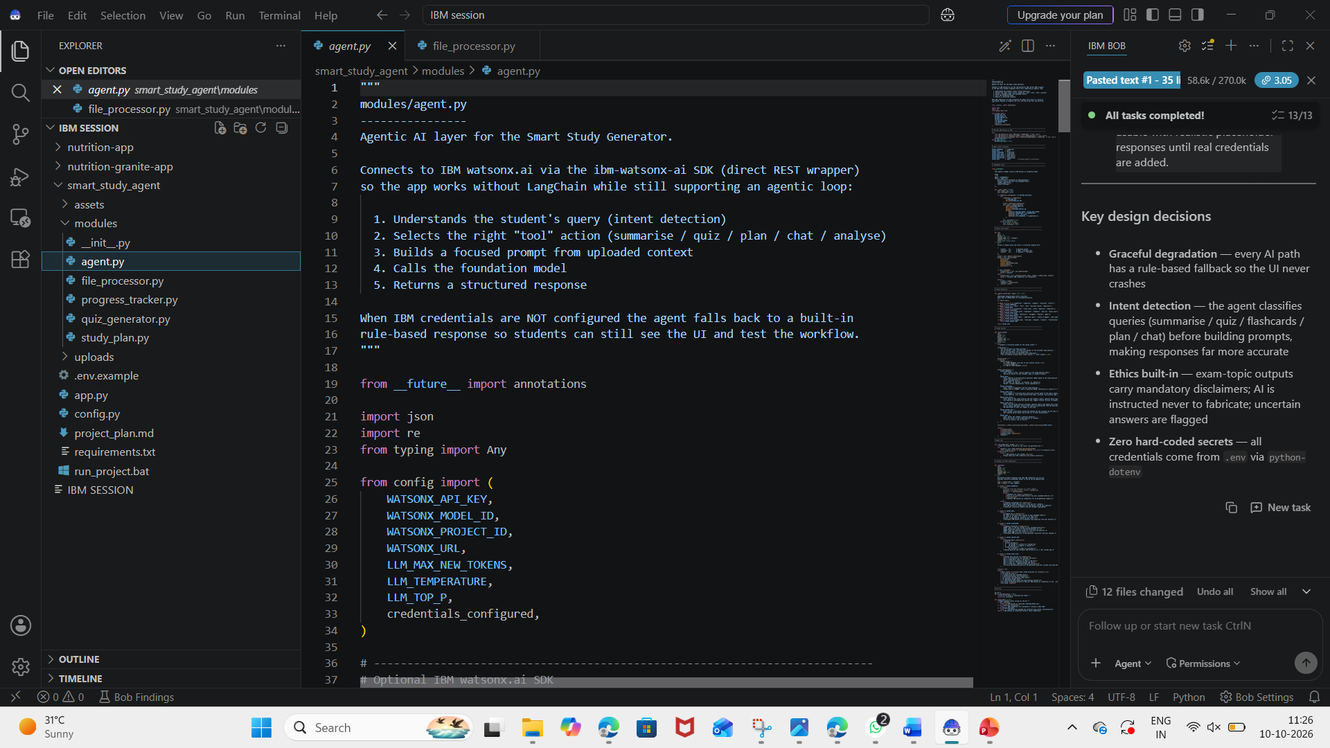
Required Files created using IBM bob -
App.py
Requirements.txt
Style.css
.env
Index.html

Slide 7
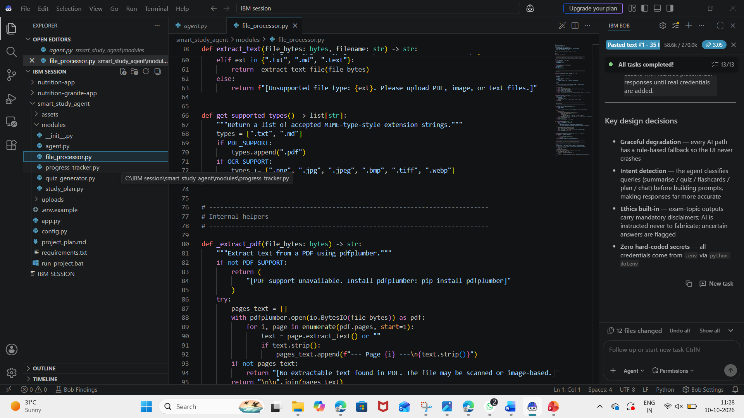
IBM Bob Screenshots:

Slide 8
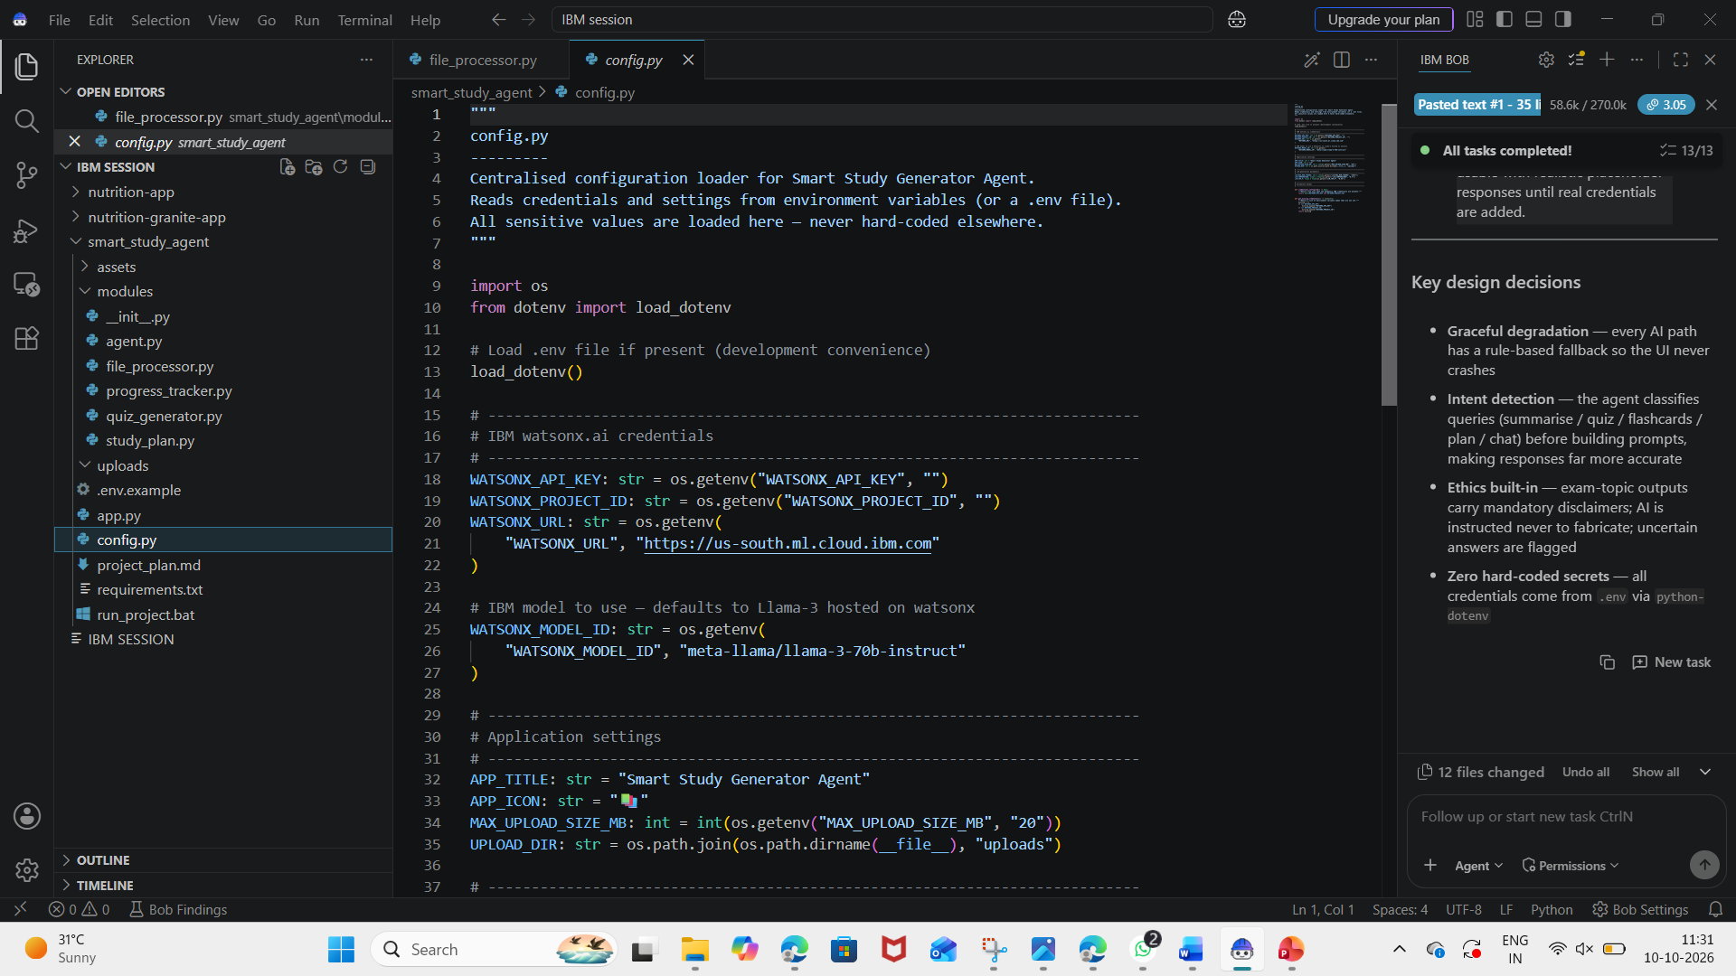

Slide 9
Git Hub Link
· Please create public github repository (Enable Add README button while creating repository) with format –
Please test and Paste the working Github URL –
Make sure you have Uploaded following three files into your github repository
1) All Agent relevant files of IBM Cloud , 2) yourproblemstatement.pdf file 3) your projectpresntation.pptx file 4)any other files
·
·
·

Slide 10
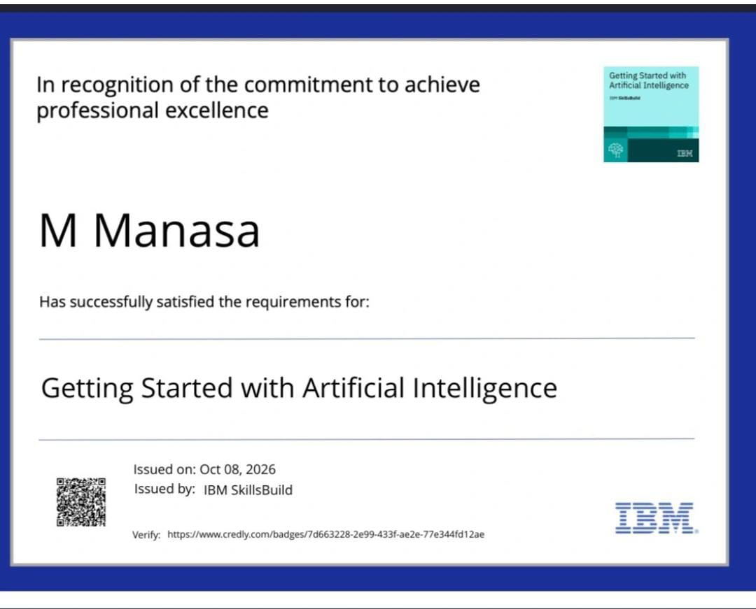
Certificates Earned:

Slide 11
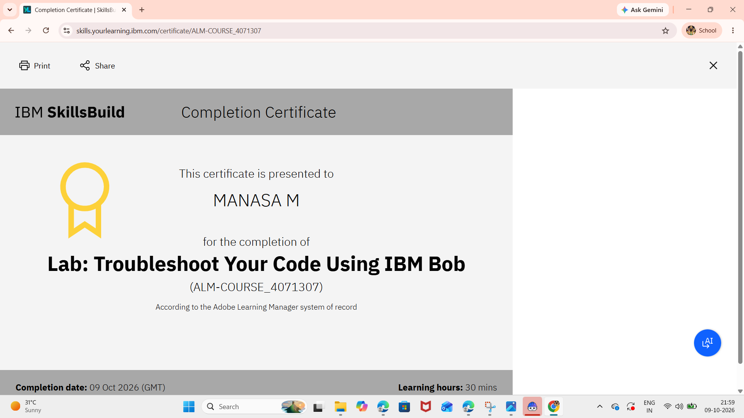
Certificates Earned:​

Slide 12


